Slide 1
strategic sustainability consulting company
For Municipality of Copenhagen & Waste Service Suppliers
Sorting, reselling and recycling waste

Slide 2
Introduction
most waste produced in europe
28% of waste recycled
2022. goal

Slide 3
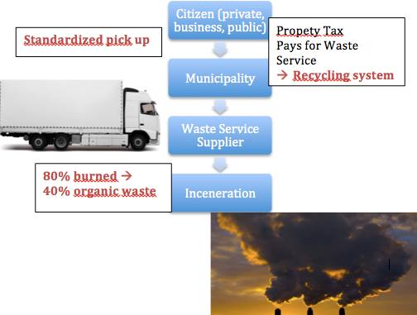
PAIN FOR COPENHAGEN
Copenhagen struggle to obtain certain objectives for sustainable waste handling
Main Objectives:
Self sufficient
Local waste sorting
Recycling (i.e. plast, organic waste, etc.)
Main challenge - Dysfuntional system
Standardaized pick up
Expensive recycling system
Still buring 80% (→ 40% of that waste is organic waste)

Slide 4
DENMARK
1 million tons of organic waste
80% incinerated → toxic fumes
SWEDEN
700 000 tons organic waste imported
99% recycled
99% non-toxic fumes

Slide 6
PAIN
Denmark produces the most waste per capita in Europe! → approx. 447 kg each year and rising
Each year around 1 million tons of organic waste is incinerated. Incineration is an obstacle in Denmark becoming a Carbon-neutral country.
80% of waste is being burned to produce heat (40% organic).
Only 28% of waste currently being recycled. Aim is to achieve 50% by 2022.
Most organic waste (which is 90% water) ends up in the oven.
There is a need to incinerate less and recycle more.

Slide 7
NUMBERS
approx. 447 kg of waste per capita and increasing!
80% of waste is incinerated for heat and electricity
40% of that waste is organic waste (around 1 million tons per year)
Only 28% of waste in total is currently being recycled

Slide 8
CURE
Mediating role
Consulting
Finding and creating buyers for waste recycling
Finding and creating partnerships with SmartBin technology
Research – optimizing waste handling systems
Help the municipality invest and implement in new technology for a tailored pickup system = reducing costs and leveraging sorting
Nudge the citizens to sort their waste By marketing our self – promote our self by taking contact, advertising on tv, social media.

Slide 9
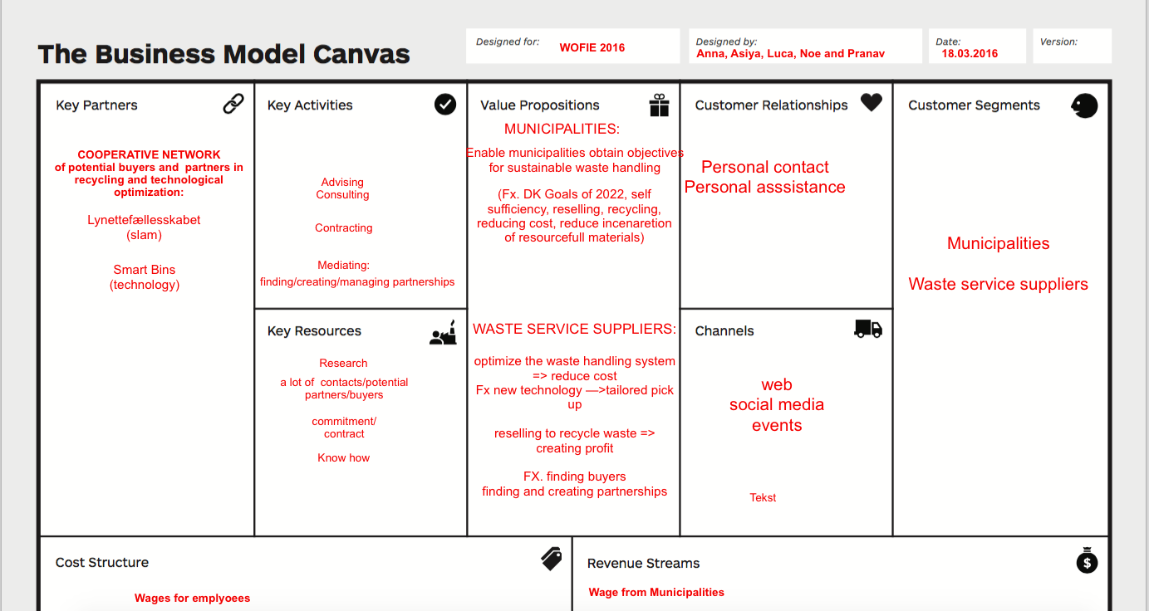
BUSINESS MODEL

